Slide 1
© Presto Plans

Slide 2
CHAPTER 1 - 2
CHARACTERIZATION
These chapters demonstrate the different social classes of the characters. The greasers are poor and live in a world where they feel disenfranchised. Danger lurks around every turn, and they feel they can only trust each other. The socs are rich and are
perceived by the greasers as a
spoiled group who has no
problems in their lives. The
newspapers will criticize the
socs one minute and then
celebrate them the next.
© Presto Plans
© Presto Plans

Slide 3
CHAPTER 1 - 2
CHARACTERIZATION
Although there is a strict divide between the greasers and the socs, it is clear that Hinton does not believe the group defines each individual. For example, Ponyboy is a greaser, but he does not fit the role of a tough gang member. He enjoys nature,
reading, and staying out of trouble.
Also Cherry Valance does not play
the ‘spoiled rich’ character role.
She is sympathetic and warm.
© Presto Plans
© Presto Plans

Slide 4
CHAPTER 1 - 2
CHARACTERIZATION
Darry is presented as the group leader in these chapters. He has been forced to sacrifice his education and take on the role of provider after the death of his parents. Although the
greasers are portrayed as a tough
street gang, they have a strong
moral compass, and their loyalty
to each other is already made clear.
© Presto Plans
© Presto Plans

Slide 5
CHAPTER 1 - 2
Important Ideas: Similarities Between Members Of Different social Classes
Although there is constant conflict between the socs and the greasers, Hinton begins to show that the two groups are not as different as they appear. We see that both groups are capable of committing crimes from the socs attempting to jump Ponyboy, to Dally slashing Tim’s tires. However, we also see that both groups can be sympathetic, warm, caring, and well-rounded. Ponyboy shows an interest in reading and nature, while Cherry’s positive interactions with Ponyboy puts a more positive face on the socs.
© Presto Plans
© Presto Plans

Slide 6
CHAPTER 1 - 2
THEME: GENDER
In these chapters, Hinton suggests that male-female friendships between the socs and greasers are more likely to remain peaceful. The male-male encounters in these chapters result in violence, while the male-female interactions are positive. This demonstrates the strong masculine bond felt between the members of each group, but also the strong masculine rivalry between the greaser and soc males.
© Presto Plans
© Presto Plans

Slide 7
CHAPTER 1 - 2
THEME: GENDER
In these chapters, Hinton suggests that male-female friendships between the socs and greasers are more likely to remain peaceful. The male-male encounters in these chapters result in violence,
while the male-female interactions are
positive. This demonstrates the strong
masculine bond felt between the
members of each group, but also the
strong masculine rivalry between the
greaser and soc males.
© Presto Plans
© Presto Plans

Slide 8
CHAPTER 3 - 4
SYMBOLISM
Blue Mustang - This is a symbol of the division of class. It is presented in the novel as a symbol of the economic inequalities between the socs and the greasers. When the Mustang is present in the plot, it always brings conflict. This shows that the economic divide is a major source of conflict between the two groups. The soc’s car shows their wealth, while the greasers
consistently traveling on
foot, vulnerable to
attack, shows their
poverty.
© Presto Plans
© Presto Plans

Slide 9
CHAPTER 3 - 4
SYMBOLISM
Rings - Bob’s rings are also a symbol of the economic inequalities that are present in the novel. This symbol; however,
brings the conflict to a new
level as it also symbolizes
how wealth (rings) can be
used as a weapon.
© Presto Plans
© Presto Plans

Slide 10
CHAPTER 3 - 4
SYMBOLISM
Hair - The greasers’ hair is symbolic in that it represents the greasers as a unified group. Since greasers cannot represent themselves in the same way the socs do (cars, jewelry), they use their hair as an identifying symbol.
© Presto Plans
© Presto Plans

Slide 11
CHAPTER 3 - 4
THEME: MORALITY
The theme of morality plays a role in these chapters. While Johnny has committed the terrible act of murder, he does so to save his friend. If he had not attacked Bob, Ponyboy would have drowned in the fountain.
Although his actions are corrupt, his values and the readers’ sympathy for him as a character remains
intact because Johnny’s intentions were honorable.
© Presto Plans
© Presto Plans

Slide 12
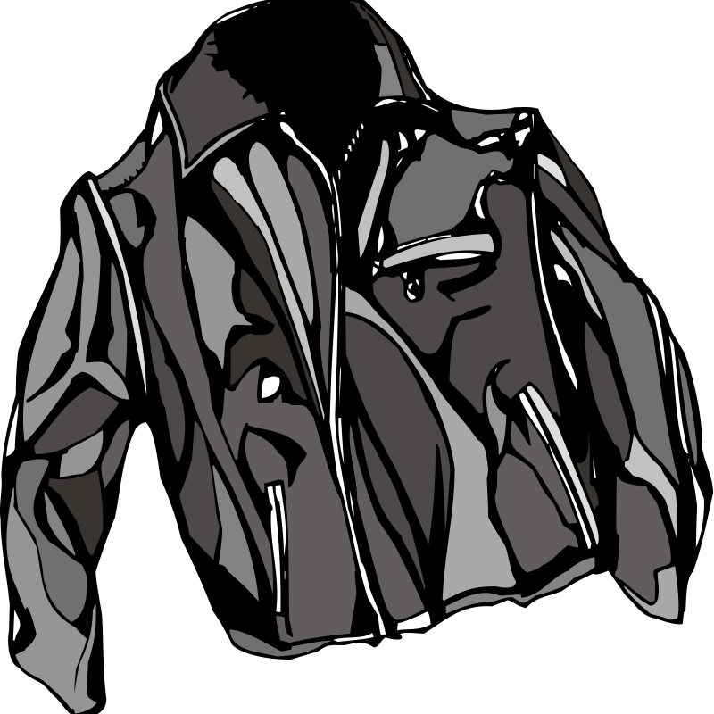
CHAPTER 3 - 4
THEME: APPEARANCES
The greaser’s awareness of how they appear to the socs is becomes an important theme in these chapters. When the socs pull up in their mustang, it states that
"Two-bit took a long drag on his cigarette,
Johnny slouched and hooked his
thumbs in his pockets, and I
stiffened” (45). Ponyboy also states
that they “can look meaner than
anything…looking tough comes
in handy"(45). The greasers
want to appear tough as a form
of protection.
© Presto Plans
© Presto Plans

Slide 13
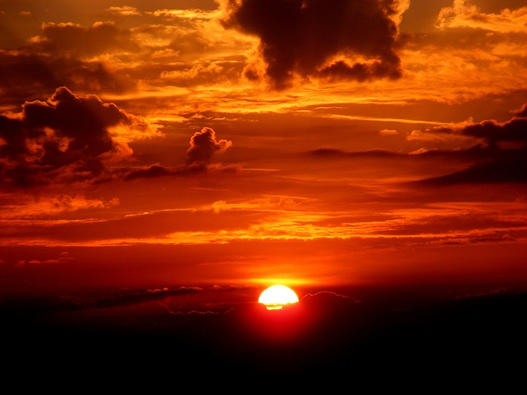
CHAPTER 3 - 4
CHARACTERIZATION
Ponyboy, in these chapters, begins to truly examine the idea that the socs and the greasers are not as different as they appear. This is shown most notably when he states about Cherry that “maybe the two different words we lived in weren’t so different. We saw the same sunset” (41).
© Presto Plans
© Presto Plans

Slide 14
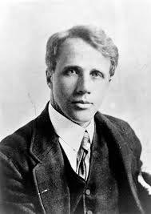
CHAPTER 5 - 6
LITERARY ALLUSION
These chapters allude to two literary works. Firstly, the poem “Nothing Gold Can Stay” by Robert Frost is read. This poem becomes an important symbol in the novel for holding onto innocence and purity. Johnny makes a connection with the poem, and it later forges an even stronger connection between him and Ponyboy (more on this later!)
© Presto Plans
© Presto Plans

Slide 15
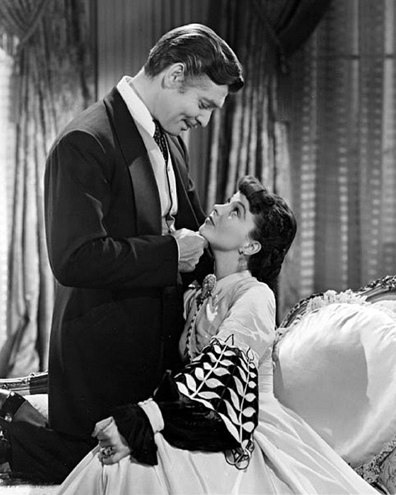
CHAPTER 5 - 6
LITERARY ALLUSION
The second literary reference made is to Gone With The Wind. This text is used to reveal Johnny’s perspective. Through the reading, Johnny connects
the southern gentleman’s
gallant nature in the novel to
the greasers, particularly to Dally, and Ponyboy begins
to understand “the extent
of Johnny's hero-worship
for Dally Winston” (76).
© Presto Plans
© Presto Plans

Slide 16
CHAPTER 5 - 6
IMPORTANT IDEAS: HAIR
When Johnny and Ponyboy cut and dye their hair, they symbolically shed their social identity. Their hair identified them as greasers, and by cutting it, they are able to break free from their social category and connect with each other on a deeper level.
© Presto Plans
© Presto Plans

Slide 17
CHAPTER 5 - 6
CHARACTERIZATION
Chapter 6 is used to mirror the events in chapter 4. Ponyboy and Johnny change from run away criminals to heroes through their decision to go into the burning church. By going against Dally’s wishes and running into the
burning church, the two boys demonstrate their
independence and their selflessness.
Hinton proves, through this heroic act,
that their membership to the greaser
gang does not define them as
individuals and that the stereotypical
definition of a greaser does not apply.
© Presto Plans
© Presto Plans

Slide 18
CHAPTER 7 - 8
IMPORTANT IDEAS: FAMILY
These chapters examine the importance of family bonds. Although Ponyboy does not get along with his brother Darry, when there is a potential that the state may remove him from the home, it is clear that Ponyboy does not want to leave his family. The reader also feels sadness for this possibility as Pony is slowly starting to see that
Darry cares for him. It is also important to
note that the greasers, although not blood
related, show many of the characteristics of
a strong family. They show loyalty, love,
and compassion for one another.
© Presto Plans
© Presto Plans

Slide 19
CHAPTER 7 - 8
IMPORTANT IDEAS: FAMILY
We also see in these chapters that for some, particularly Johnny, the greasers are more important to him than his biological family. He shows preference for his friends over his dysfunctional family when he refuses his mother. While she has failed him as
a mother, Ponyboy, Two-bit and
Johnny have provided him with
the love he was lacking.
© Presto Plans
© Presto Plans

Slide 20
CHAPTER 7 - 8
THEME: INDIVIDUAL VS GROUP
Ponyboy breaks with his traditional thinking of greasers vs socs, and begins to realize in these chapters that all people are individuals. Through his conversation with Cherry, we see Ponyboy’s perspective that the individual is as important as the group. He explains
this by explaining to Cherry that no
matter if you are from the East or the
West side, you see the same sunset. This
is symbolic of the similarities of the
two sides and shows that regardless of
social associations, we are all individuals.
© Presto Plans

Slide 21
CHAPTER 7 - 8
THEME: INDIVIDUAL VS GROUP
This idea is extended when he speaks with Randy. Although Randy was Bob’s best friend, he is able to look past
his group association to the
socs and hold the same
perspective as Ponyboy that
the violence must end.
© Presto Plans

Slide 22
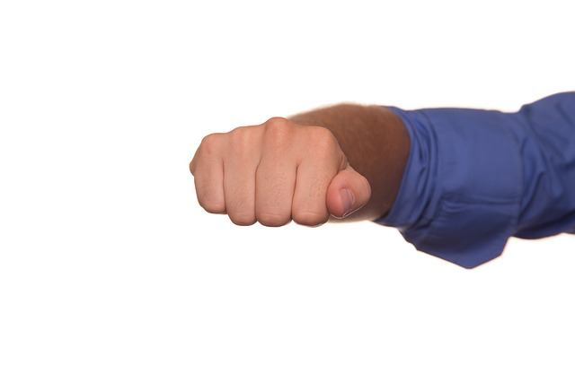
CHAPTER 9 - 10
THEME: GROUP MENTALITY
The constant battle between the socs and the greasers has become a tradition and an expectation for members of each group. The rumble is important because it shows the underlying struggle between the instinct to make peace with the social obligation to fight. This is most notable in the fight between Darry and Paul. The two are friends and football teammates, yet they go against what they believe to be morally right for the
sake of keeping tradition. The two
are friends with much in
common, but the division in
class forces them to be enemies.
© Presto Plans

Slide 23
CHAPTER 9 - 10
THEME: GROUP MENTALITY
Another example of the strength of group
mentality is demonstrated through
Ponyboy’s hesitation to fight. He
feels tension and his instincts
encourage him to not take part in
the rumble. Even still, Ponyboy
goes along with the fight to show
support to his social group. He knows
his participation in the fight makes
him a member of the gang.
© Presto Plans

Slide 24
CHAPTER 9 - 10
CHARACTERIZATION
After the death of Dally and Johnny, Ponyboy becomes physically and emotionally affected. He not only must recover from his physical injuries, but he cannot cope emotionally with his loss. His grades begin to suffer, and his
relationship with Darry deteriorates.
Although Ponyboy is displaying
conventional characteristics of a hardened
tough greaser, they value Ponyboy’s true
self so they show great concern. This
shows the greasers value his individuality
more than as his role in the social group.
© Presto Plans
© Presto Plans

Slide 25
CHAPTER 11 - 12
CHARACTERIZATION
By the end of the novel, Ponyboy moves away from his bitterness through the resolution of the issues with his brothers. In the end, he attempts to show other boys his age in difficult
positions that their voices
matter. He does this by
sharing his story in his
English theme paper.
© Presto Plans
© Presto Plans

Slide 26
CHAPTER 11 - 12
THEME: ACTIONS VS. WORDS
The letter written by Johnny inspires Pony to take up a different kind of weapon to fight his battle –his pen, which Pony uses
to nonviolently transform his world and to positively shape the worlds of
other boys like him.
© Presto Plans
© Presto Plans

Slide 27
The original purchaser of this document is granted permission to copy for teaching purposes only. If you are NOT the original purchaser,
please download the item from my store before making any copies. Redistributing, editing, selling, or posting this item or any part
thereof on the Internet are strictly prohibited without first gaining permission from the author. Violations are subject to the penalties of
the Digital Millennium Copyright Act. Please contact me at prestoplans@gmail.com if you wish you be granted special permission
You can visit my store at
http://www.teacherspayteachers.com/Store/Presto-Plans
© Presto Plans

